Slide 1
Section R.4
Polynomials
Copyright © 2012 Pearson Education, Inc. Publishing as Prentice Hall.

Slide 2

Copyright © 2012 Pearson Education, Inc. Publishing as Prentice Hall.

Slide 3
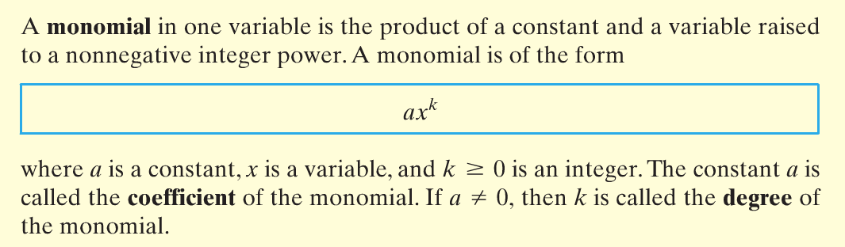
Copyright © 2012 Pearson Education, Inc. Publishing as Prentice Hall.

Slide 4


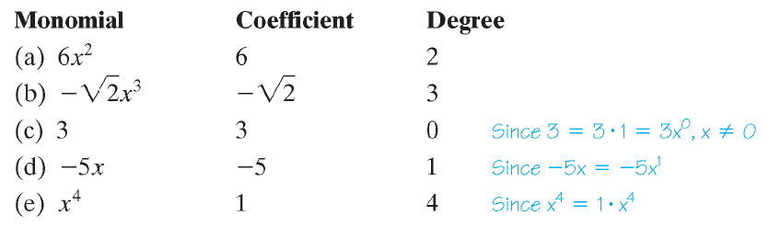
Copyright © 2012 Pearson Education, Inc. Publishing as Prentice Hall.

Slide 5
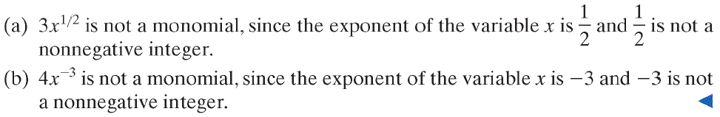
Copyright © 2012 Pearson Education, Inc. Publishing as Prentice Hall.

Slide 6

Copyright © 2012 Pearson Education, Inc. Publishing as Prentice Hall.

Slide 7
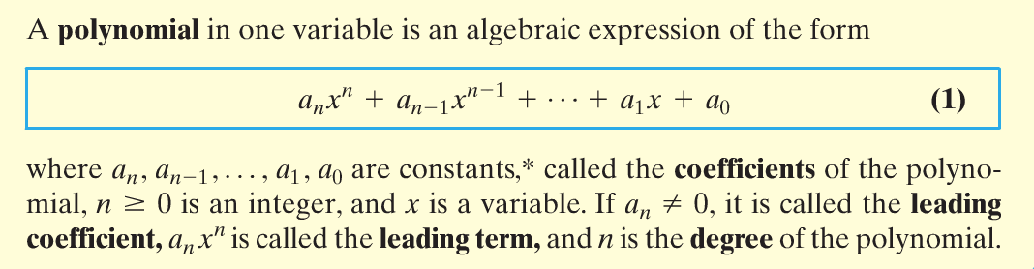
Copyright © 2012 Pearson Education, Inc. Publishing as Prentice Hall.

Slide 8
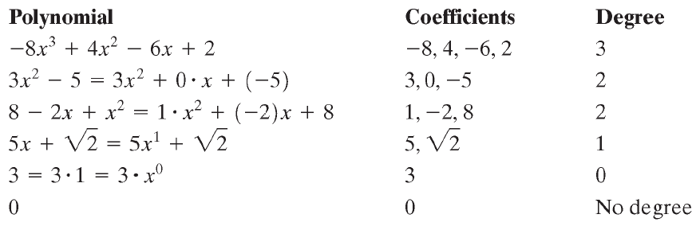
Copyright © 2012 Pearson Education, Inc. Publishing as Prentice Hall.

Slide 9

Copyright © 2012 Pearson Education, Inc. Publishing as Prentice Hall.

Slide 10


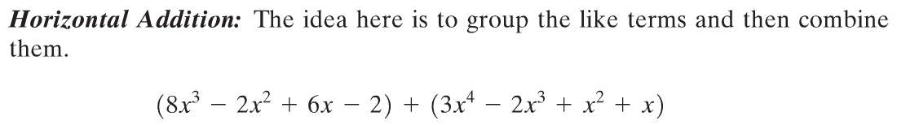

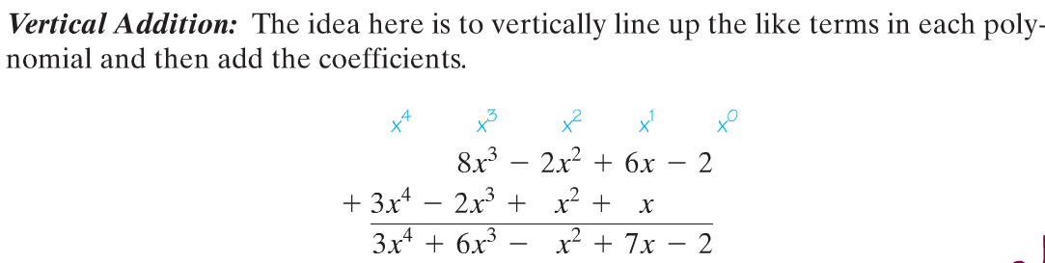
Copyright © 2012 Pearson Education, Inc. Publishing as Prentice Hall.

Slide 11
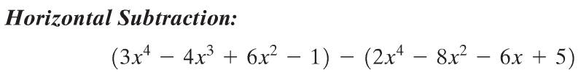
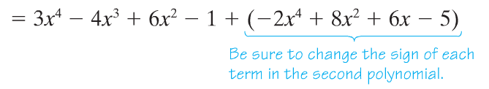
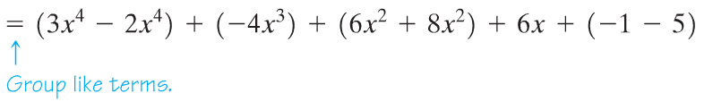

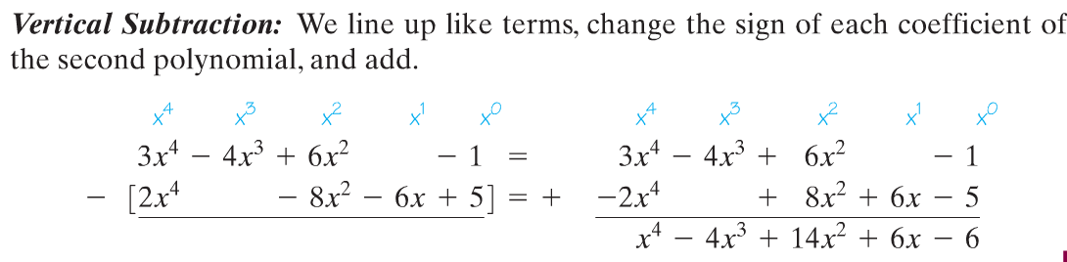
Copyright © 2012 Pearson Education, Inc. Publishing as Prentice Hall.

Slide 12

Copyright © 2012 Pearson Education, Inc. Publishing as Prentice Hall.

Slide 13

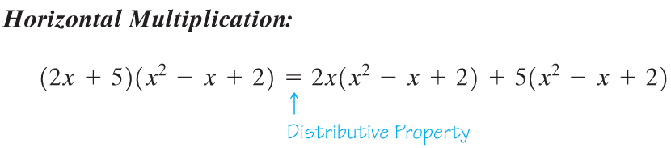
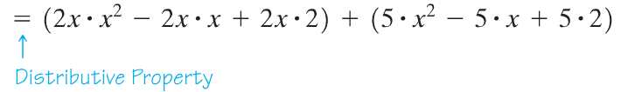
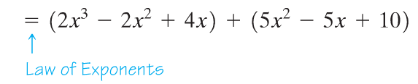
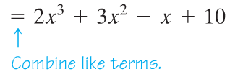
Copyright © 2012 Pearson Education, Inc. Publishing as Prentice Hall.

Slide 14
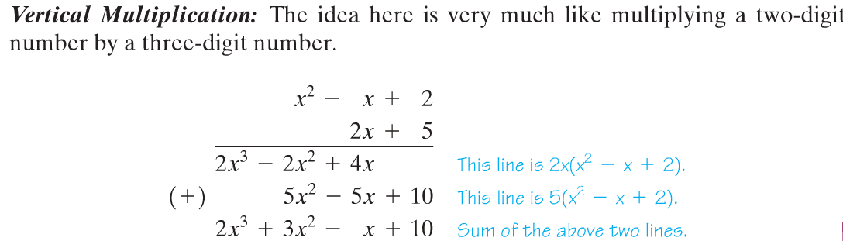
Copyright © 2012 Pearson Education, Inc. Publishing as Prentice Hall.

Slide 15

Copyright © 2012 Pearson Education, Inc. Publishing as Prentice Hall.

Slide 16
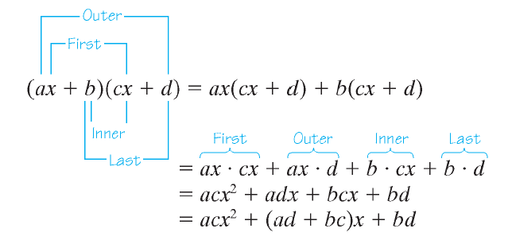
FOIL
Copyright © 2012 Pearson Education, Inc. Publishing as Prentice Hall.

Slide 17

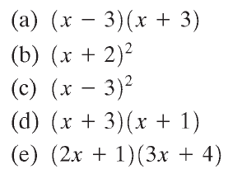

Copyright © 2012 Pearson Education, Inc. Publishing as Prentice Hall.

Slide 18



Copyright © 2012 Pearson Education, Inc. Publishing as Prentice Hall.

Slide 19
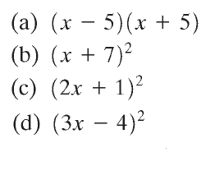




Copyright © 2012 Pearson Education, Inc. Publishing as Prentice Hall.

Slide 20

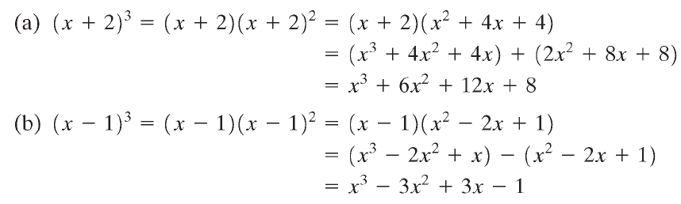

Copyright © 2012 Pearson Education, Inc. Publishing as Prentice Hall.

Slide 21
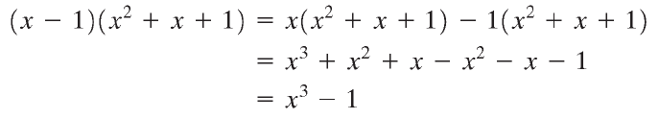
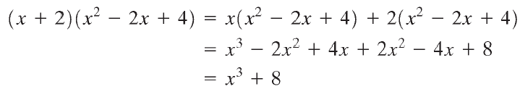




Copyright © 2012 Pearson Education, Inc. Publishing as Prentice Hall.

Slide 22
Copyright © 2012 Pearson Education, Inc. Publishing as Prentice Hall.

Slide 23

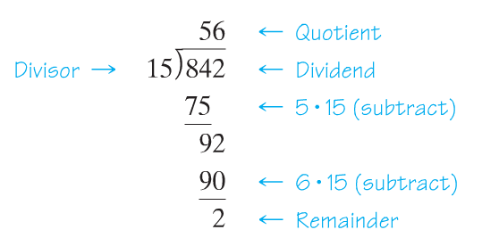

Copyright © 2012 Pearson Education, Inc. Publishing as Prentice Hall.

Slide 24

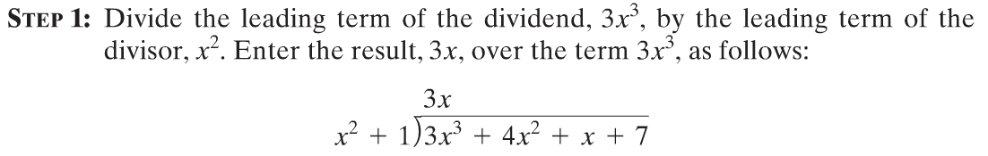
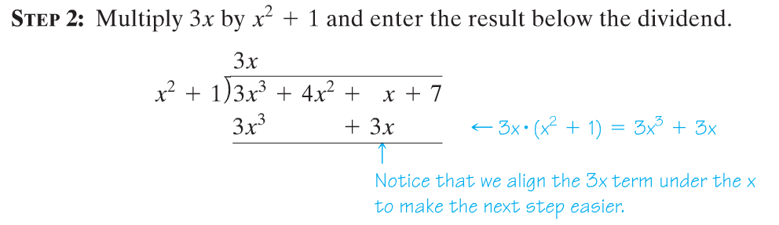
Copyright © 2012 Pearson Education, Inc. Publishing as Prentice Hall.

Slide 25
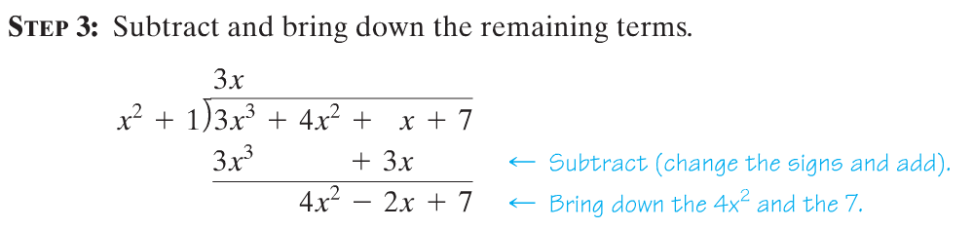
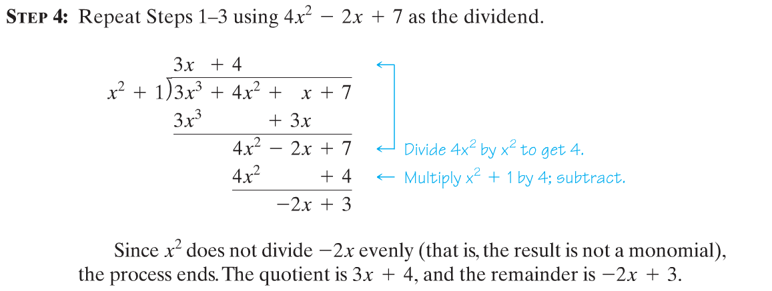
Copyright © 2012 Pearson Education, Inc. Publishing as Prentice Hall.

Slide 26
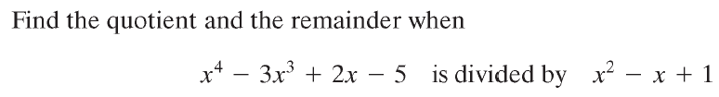
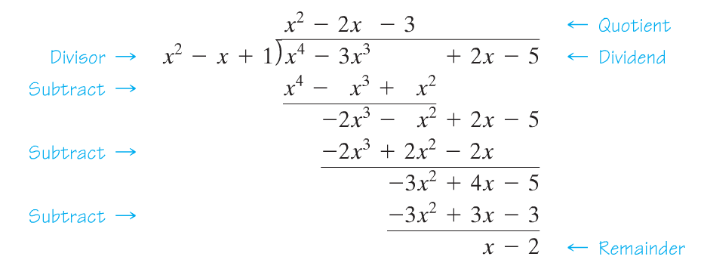
Copyright © 2012 Pearson Education, Inc. Publishing as Prentice Hall.

Slide 27

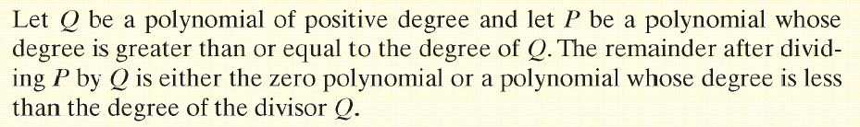
Copyright © 2012 Pearson Education, Inc. Publishing as Prentice Hall.

Slide 28
Copyright © 2012 Pearson Education, Inc. Publishing as Prentice Hall.

Slide 29
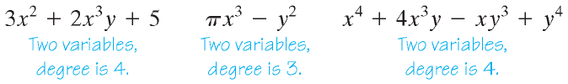
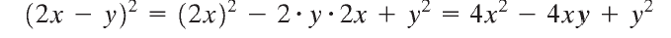
To multiply (2x - y)² use the Squares of Binomials formula with 2x instead of x and y instead of a.
Copyright © 2012 Pearson Education, Inc. Publishing as Prentice Hall.

